Slide 1
FBI Agile Transformation
Carol Connors
Lead Agile Coach
Strategic Alignment and Organizational Transformation Task Lead

Slide 2
Overview
IT Infrastructure Division
Provides infrastructure for 56,000 people around the globe
The backbone of FBI IT- accounts, skype, conferencing, data centers, networks, laptops, phones, email, and much more!
36,000 mobile devices
100,000 workstations
4 enclaves
Vision- “Better, Faster, Stronger”
Mission- “Provide the FBI with IT Infrastructure services that are agile and innovative in support of the FBI’s mission”
650+ people: DC, West Virginia, Idaho
$213 million budget
National Program Review reported- lack of cross unit/division collaboration, lack of executive roadmap/ upper management guidance, lack of documentation, no transparency or visibility
Success with Mobility ART received executive attention and led them to engage MITRE to implement Agile across the entire division

Slide 3
What did we do?
Launched 100% of division in 5 months
Promoted self organization across squads, units, divisions
9 ARTs, 60+ squads, 650+ people
Created Agile Transformation website
Created tracking tool (in absence of JIRA)
Created Custom Agile class for infrastructure teams
Trained Traditional PMs in Agile/SAFe to serve as POs, SMs or RTEs
Trained 8 first time government/contractor RTEs
Conducted on-going training for ITID, CIO, Security, Branch Front Office, Other divisions
Launched Prioritization Review Board
Conducted Innovation Week

Slide 4
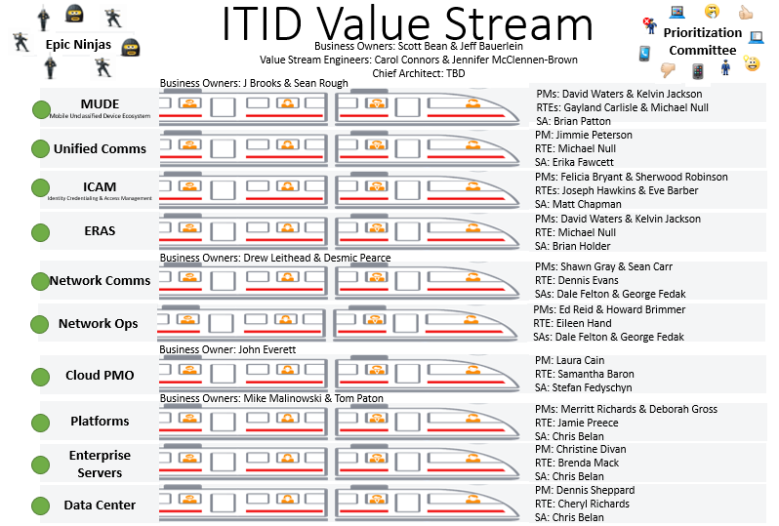
ITID’s Structure
Epic Ninjas and Epic Owners
Prioritization Review Board

Slide 5
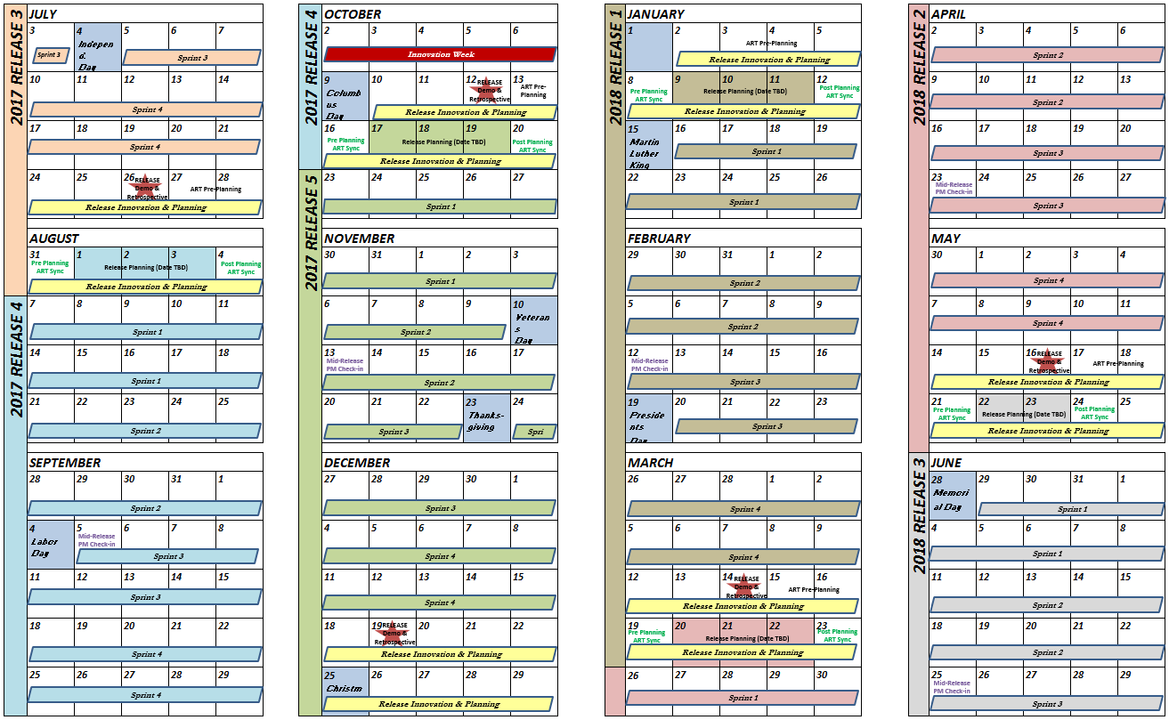
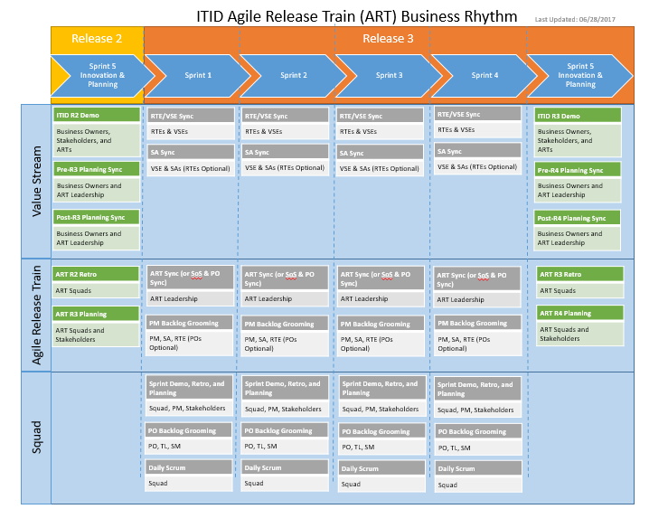
Common Calendar and Cadence

Slide 6
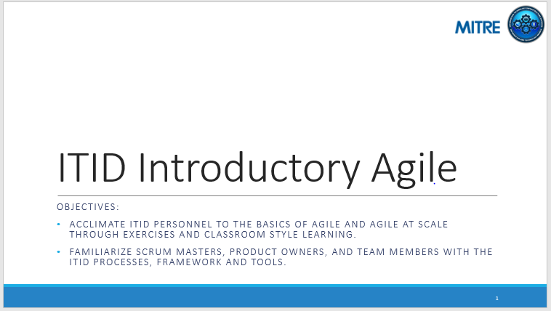
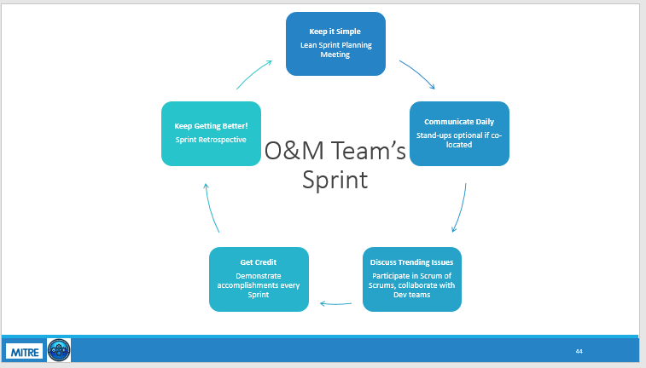
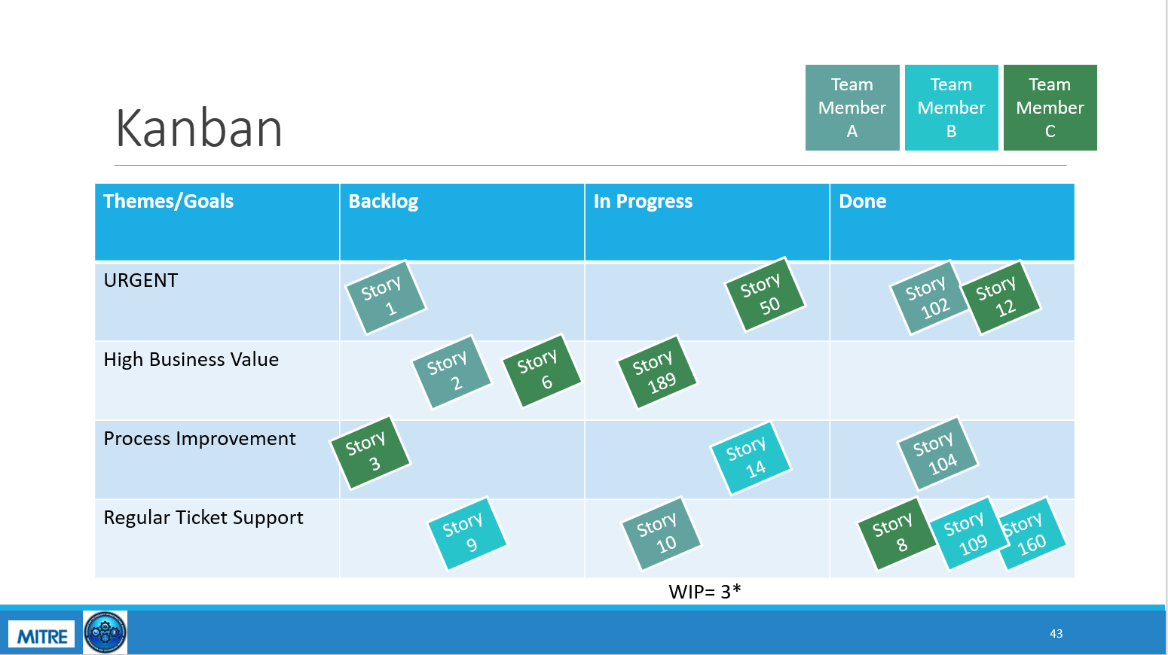
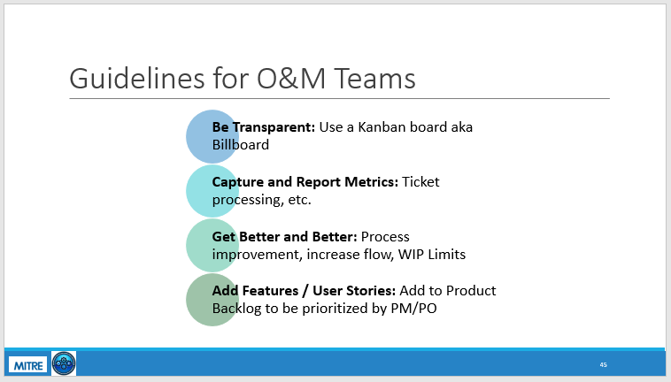
Custom Class

Slide 7
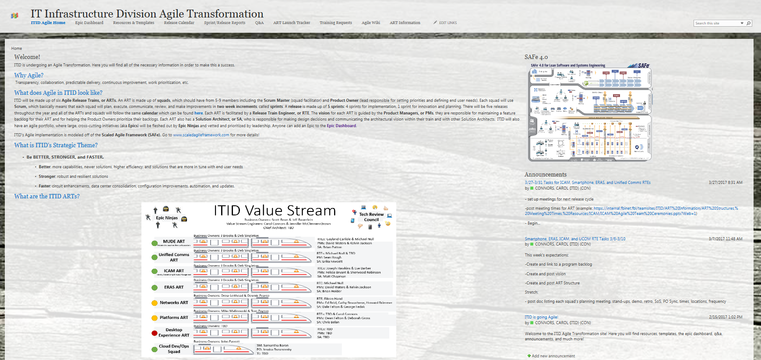
Website
ITID’s Strategic Theme
ITID’s Calendar
Pages for each ART:
leadership structure
vision
feature backlog link
sprint tracker link
roadmap
structure
documents
sprint and release demo slides/artifacts
Epic Dashboard
Training Requests forms and Training Materials
RTE Toolbox: ART Launch Tracker, Wiki, Templates, Resources
Innovation Week Idea Factory

Slide 8
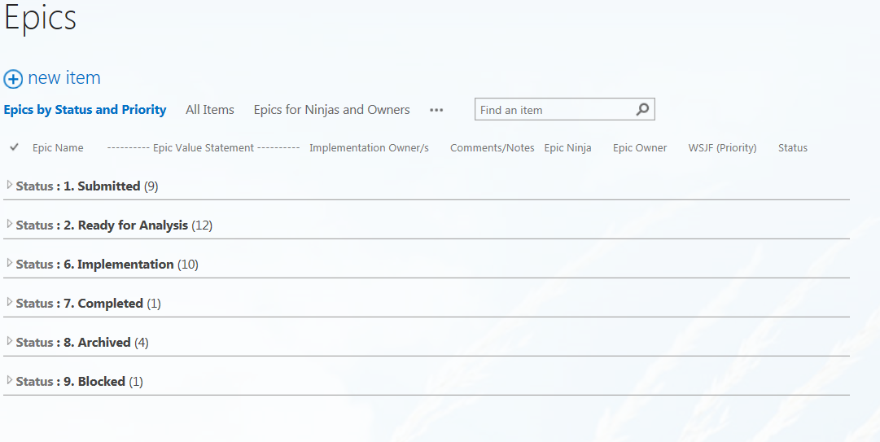
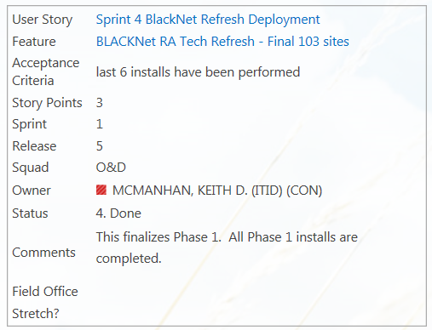
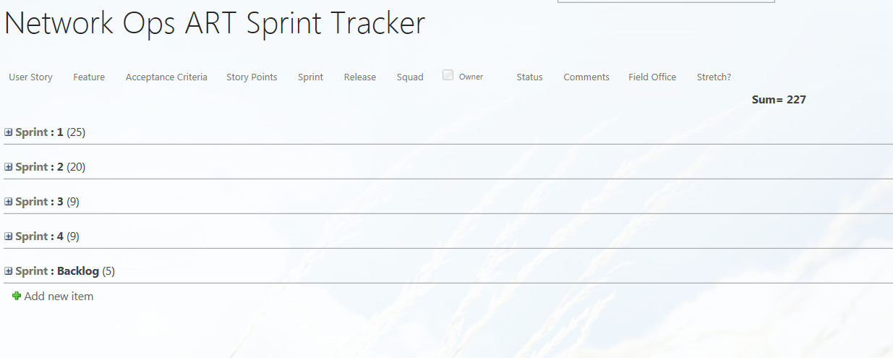
Custom SharePoint Trackers
Built custom user story, feature, and epic trackers in SharePoint
Tracker are all linked to show hierarchy
Information is displayed in “cards” and are grouped by sprint and release
Total transparency
Branch Front Office is using tracker to pull information, reduce data calls and replace traditional reporting/governance practices

Slide 9
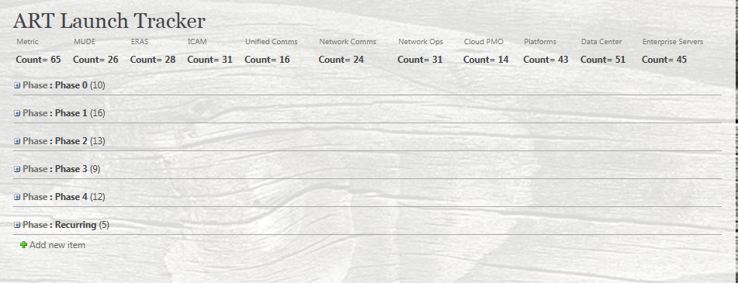
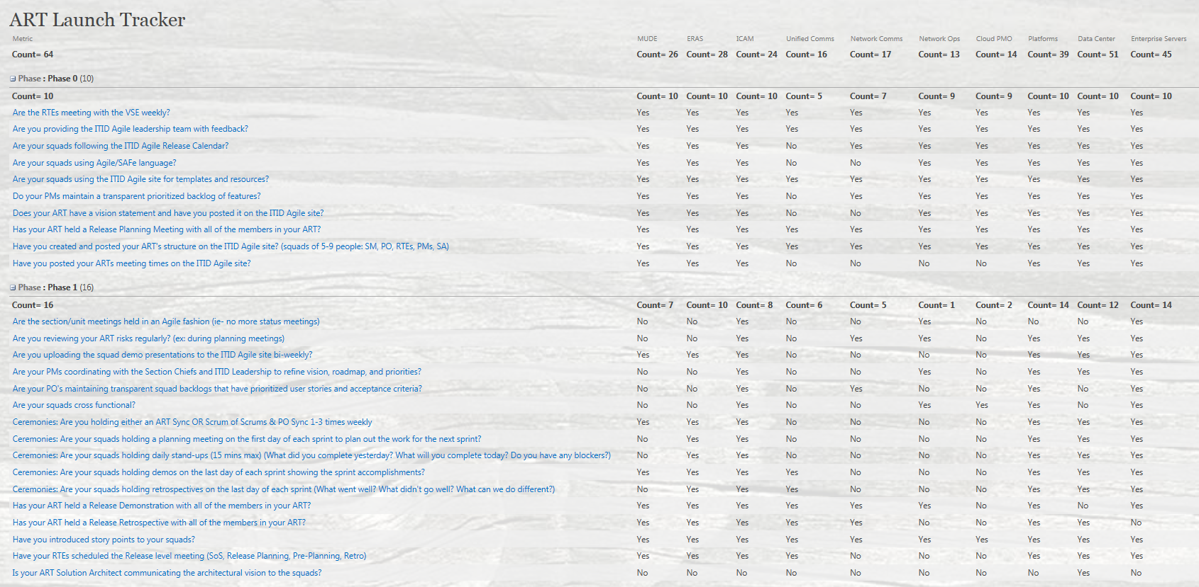
ART Launch Tracker

Slide 10
Innovation Week
The rules:
Work on whatever you want for a week
Inside or outside of lane
Can work individually, in pairs, or in groups
Just have something to show for it at the end of the week
Best Innovation Demos were showcased to leadership during Release Demos
Outcomes
42 Innovation Ideas submitted to the Idea Factory (cost savings, ROI, new ideas, improvements, tools)
35 ideas worked
28 ideas demoed
15 ideas added as Features/Epics
8 ideas were committed as features in this Release (will be deployed in Dec 2017)
300+ attendees

Slide 11
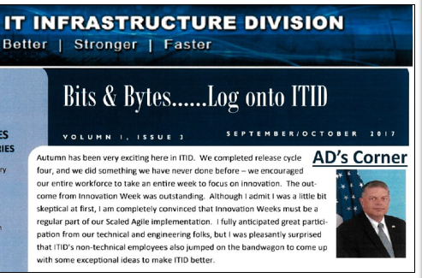
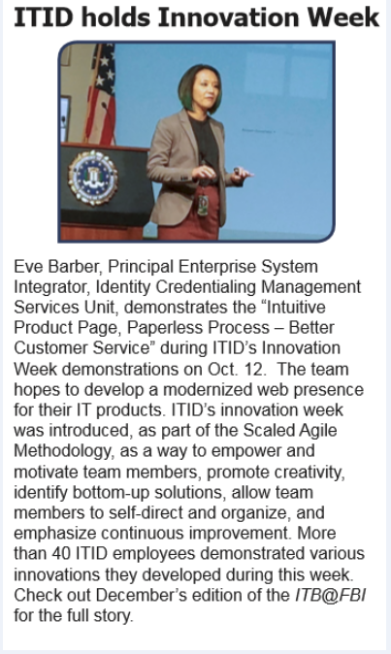
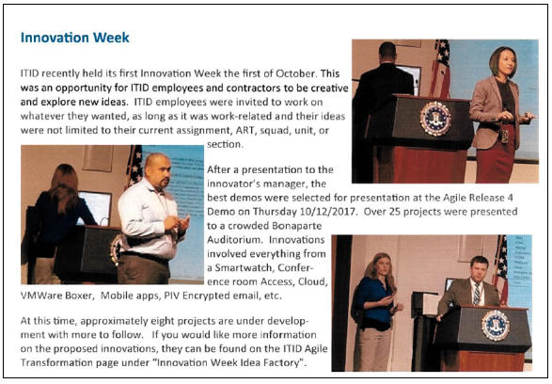
Innovation Week – In the News!

Slide 12
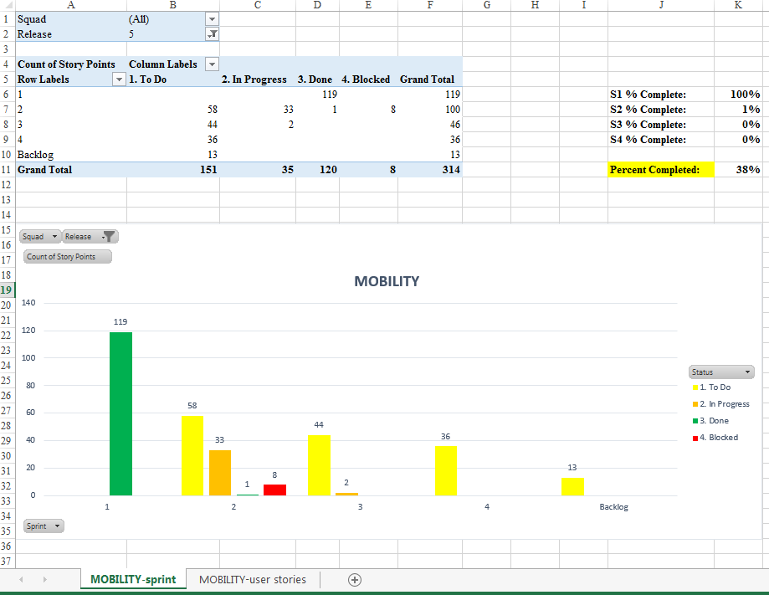
Innovation Idea – Agile Metrics

Slide 13
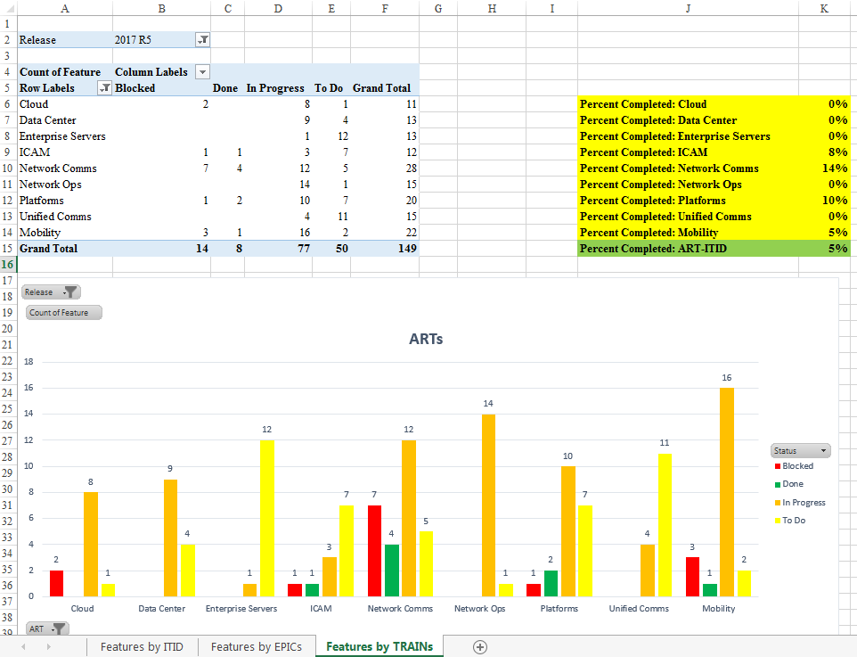
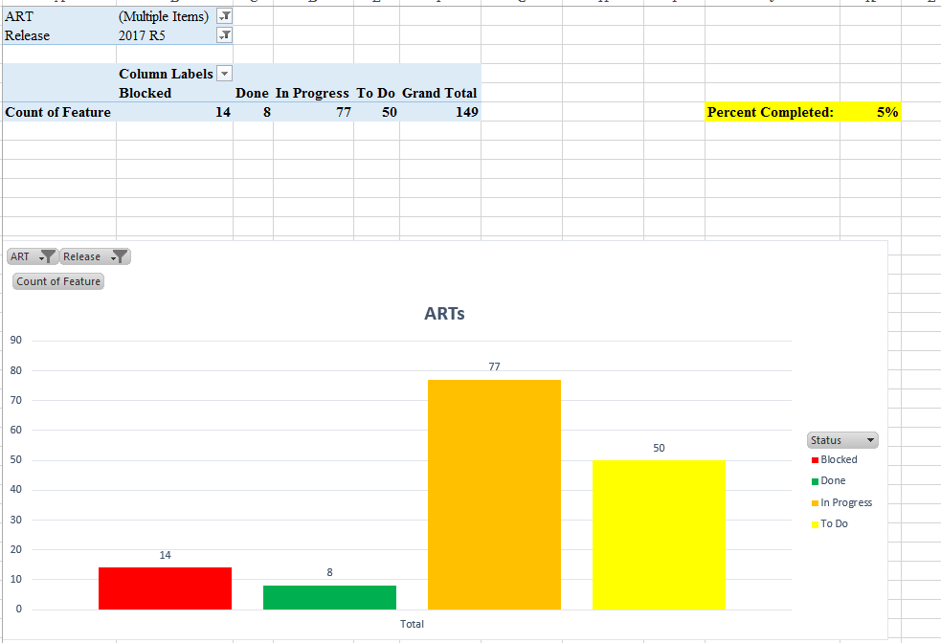
Innovation Idea – Agile Metrics

Slide 14
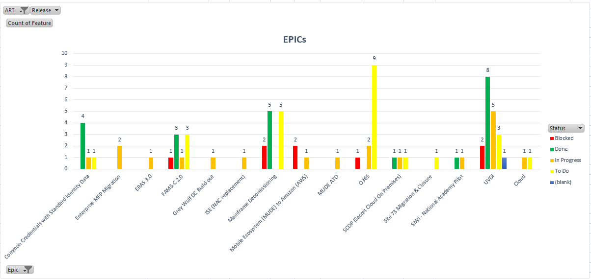
Innovation Idea – Agile Metrics

Slide 15
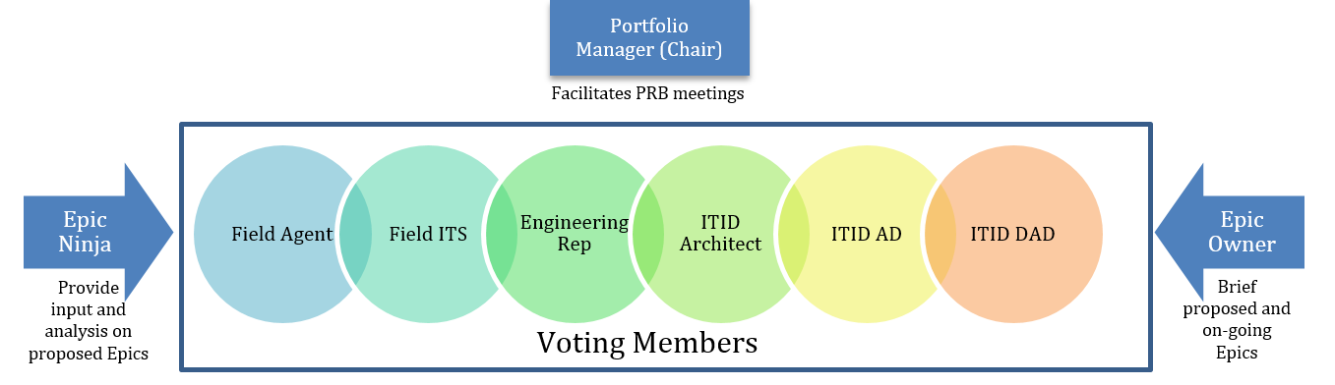
Prioritization Review Board (PRB)
Evaluates and Prioritizes Newly Submitted Epics. The PRB must evaluate and prioritize newly submitted Epics and on-going Epics using Weighted Shortest Job First (WSJF) each Release Cycle
Reviews and Re-Priorititzes In Progress Epics: An Epic Health will be presented to the PRB by the Epic Owner at the end of each Release Cycle so they can vote to continue, pause, terminate, pivot, or complete the epic.

Slide 16
PRB Mission
“The IT Infrastructure Division (ITID) employs the Agile Methodology as a best practice for managing initiatives that serves the following goals: adaptive planning, evolutionary development, early delivery, and continuous improvement. As part of the Agile Methodology, ITID instituted a Prioritization Review Board (PRB). The mission of the PRB is to review, prioritize, and vote on large, cross-cutting initiatives that are substantial in size and scope, also known as Epics, on a pre-set cadence tied to ITID’s Agile release cycles.”

Slide 17
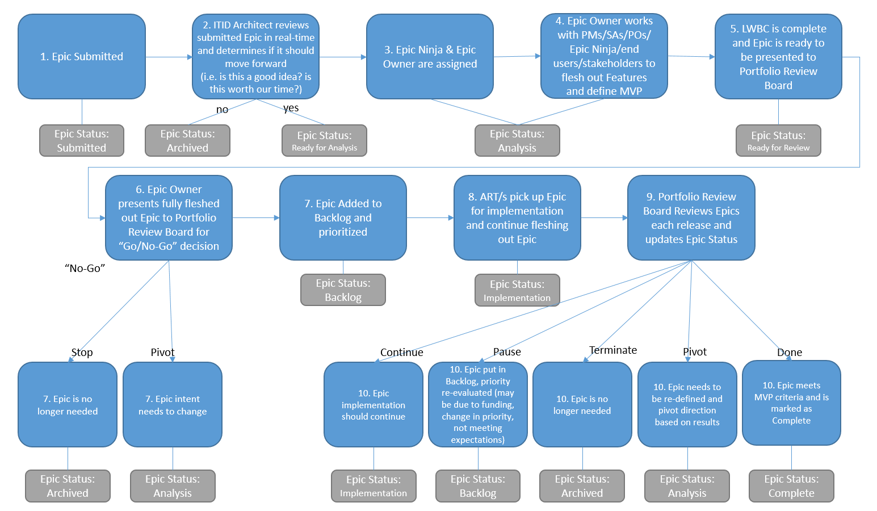
Epic Process

Slide 18

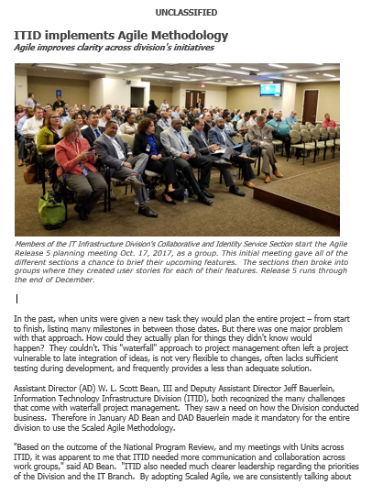
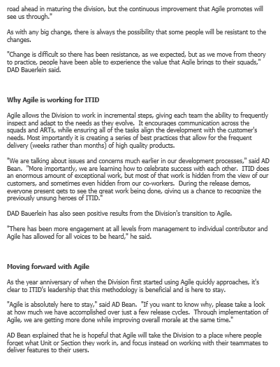
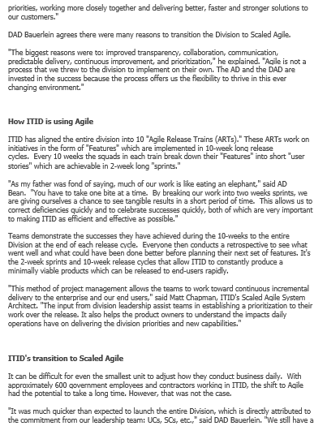
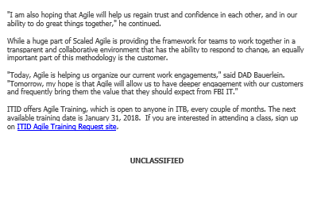
Agile Article in Branch Newsletter

Slide 19
Successes
Data calls went from taking days to minutes
Blockers are addressed more rapidly
Quick learning
Branch sees value and is adjusting governance and reporting practices to align with agile
All traditional Project Managers are successfully holding Agile roles
Collaboration and transparency have increased
Division wide technical dependencies and roadmap discussions happen bi-weekly
Division wide blockers are discussed at least weekly
Remote users feel more engaged and in the loop
No clear processes/prioritizes -> clear prioritized backlogs and taskboards across all ARTs and Squads
Trained ~250 individuals from both in and outside of ITID
Brought Security into the loop and engaged them in release cycles and sprints
Tangible, transparent accomplishments bi-weekly
Standard documentation/serialization every 10 weeks for the entire division

Slide 20
Retrospective – Month 10
What went well?
Full division of 650 people launched in 10 release trains and 60 squads in less than 5 months
Leadership buy-in, engagement, and commitment
Created a one-stop-shop website for anything relating to the Agile Transformation
Regular engagement and meeting with executives throughout the transformation
Custom training class held for internal and external personnel and stakeholders as needed. Class married up SAFe and Scrum concepts to the FBI environment and outlined deviations/modifications to the framework to support infrastructure/O&M teams (not software dev). Trained ~250 individuals so far
Consistency. Standard framework, terms, roles, meetings for everyone in the division to follow.
Put in place a transparent location to track Epics, Features, and User Stories
Stood up a Prioritization Review Board that included field representation to prioritize and evaluate Epics using Planning Poker and WSJF
Trained and coached 8 government/contract employees to be first-time Release Train Engineers
Better cross division collaboration and alignment via set Release Cycle Meetings
Allowing squads and trains to self-organize unconstrained by organizational boundaries
Tangible, live demos to external stakeholders, executives, and end users every Release
Staff felt more engaged, empowered, and motivated under the new process
Self-organization across units, squads, and divisions
Transformation leaders were charismatic, likeable, trustworthy and had strong interpersonal skills
Implementing agile incrementally and focusing on the basics then expanding agile techniques as teams/ARTs matured
Focus on sprint/release predictability vs. sprint/release velocity. This promoted better accuracy and predictability for internal and external stakeholder
Engaging external division in agile processes to share Feature/User Story requests prior to the start of each release.
New structure of SMs, RTEs, and VSEs helped blockers to be eliminated quicker
Many data calls have been eliminated because all work is tracked in one central location and managers have been coached to use the agile process/resources to get the information they need
What didn’t go well?
No standard Agile tool (JIRA) due to procurement/security issues
Other divisions/branches not Agile making decency management challenging
Took time to get security and finance engaged in agile process
Logistics for simultaneous Release Planning across 10 ARTs. Offsite locations do not have access to secret network where all work trackers are housed
3 ARTs in a different time-zone with limited travel budget. Tough to get regular agile training/on the ground coaching more than once a year
Tough for traditional mindsets to shift from Command and Control to Servant Leadership
Hard to locate rooms for Agile training and get individuals to dedicate a full 8 hours to training
Dated processes for managing “projects” and governance are not compatible with SAFe (there is no such thing as a “project”)
Legacy contracts preclude individual participation in Agile ceremonies and general processes
Initial push back from individuals saying that agile was “overwhelming” which stemmed from the fact that managers were keeping their old meetings and ways of doing business (i.e. status meetings, project presentations, unit meetings) while overlaying them with agile ceremonies
Initial pushback for tracking user stories and features in addition to the other administrative requirements (meetings and data calls)
What could have been done differently?
Created custom training sooner and trained full ARTs together prior to launching
Suggested/enforced the elimination and consolidation of non-agile meetings sooner
Have an Agile tool

Slide 21
Lessons Learned
Must have strong leadership dedication, buy-in and participation
It is more important to align personalities/characteristics to roles instead of level/experience/certifications. Agile best practices and processes can be taught; personalities are harder to morph.
Implement Agile in an agile fashion. Minimize upfront planning and start by launching trains and getting people trained. Using the concept of MVP, get teams/trains started with the basics and then build as they mature.
Weighted Shortest Job First (WSJF) is a hard sell for traditional executives who struggle ignore sunk costs (ex: large waterfall Firm Fixed Price projects)
People will resist. This is when leadership is key. It only takes one successful Release, and in some cases one successful Sprint, for people to buy in.
Often your harshest critics/resistors will become your strongest supporters/advocates
Ongoing, customized training is critical for a successful transition
Even though ITID is agile, it is difficult to manage dependencies with external entities that are not Agile (security, other divisions, suppliers, legal, finance)
There are some people who will never “like” or “buy-in to” agile, this is ok, but needs to be combatted with strong leadership up front and swiftly so they are not enabled
You need to be ready to counter false negative perceptions
There is a constant level setting/pivoting going on to ensure that people are doing “agile” the right way. Many people think that they are implementing agile correctly yet they aren’t and it created problems. Training has helped to mitigate this and empowering all individuals to hold each other accountable.
Prior to MITRE’s involvement individuals has never been given an opportunity to innovate or be creative. Innovation week was initially met with some angst and resistance because it was such a foreign concept to them. With leadership’s guidance and encouragement people got excited and came up with great ideas.

Slide 22
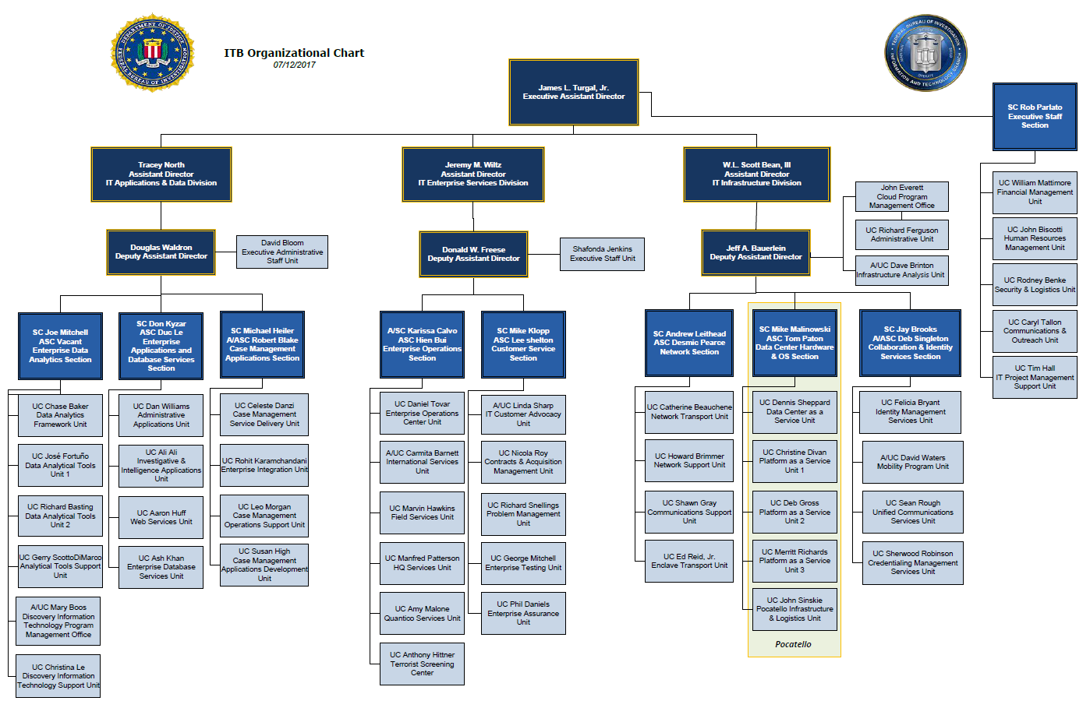
What’s Next?
Expand to branch and beyond (external units West Virginia, Quantico, CIO Office)

